Slide 1

HOW WIN FRIENDS & INFLUENCE PEOPLE
BY DALE CARNEGIE
PRANEET (GROUP LEADER & CREATIVE DIRECTOR)
(2302570049)
NOYAL (SPEAKER & PRESENTER )
(2302570023)
ANJALI (SPEAKER & PRESENTER)
(2302480001)
SONAL (SPEAKER & PRESENTER)
(2302570019)

Slide 2


TABLE OF CONTENTS
PART 01
PART 02
ABOUT THE AUTHOR
WHY SHOULD I READ THIS BOOK
PART 03
PART 04
KEY TAKE AWAY
SUMMARY
(LEARNING FROM THE BOOK)

Slide 3
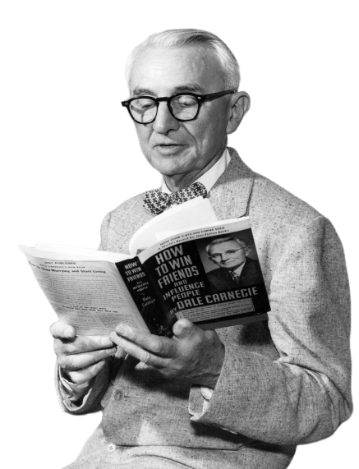
ABOUT THE AUTHOR
Dale Carnegie, Born In 1888 In Missouri, Was A Renowned American Lecturer, Author, And Pioneer In Public Speaking And The Psychology Of Success.
Despite A Humble Upbringing On A Farm, Carnegie Was Active In Debating Clubs During High School And College, And Later Worked As A Salesman And Actor In New York City.
He Eventually Taught Public Speaking At The YMCA, Where His Classes Gained Immense Popularity And Led Him To Start Publishing Pamphlets On The Subject.
Carnegie's First Major Work, "Public Speaking: A Practical Course For Business Men" (1926), Aimed To Standardize His Teaching Methods.
He Achieved Widespread Fame With "How To Win Friends And Influence People" (1936), A Book Emphasizing The Importance Of Attitude In Achieving Success.
Carnegie's Approach Capitalized On The American Desire For Success, Offering Advice That Helped Readers Feel And Potentially Become More Successful.
He Authored Other Notable Books, Such As "How To Stop Worrying And Start Living" (1948), Which Provided Practical Strategies To Reduce Stress And Anxiety.

Slide 4

WHY SHOULD YOU READ THIS BOOK
Improves Interpersonal Skills
Book Offers Practical Advice On How To Build Relationship
Communicate Effectively
Handle People With Empathy
Enhanced Leadership Abilities
Book Provides Insights Into Motivating
Inspiring Others
Conflict Resolution
This Helps You Navigate Conflicts
Teaches How To Understand Other’s Perspective
Teaches To Find Common Grounds

Slide 5
WHY SHOULD YOU READ THIS BOOK
Networking
Learning The Art Of Making Friends
Influencing People
This Develops The Ability To Connect With People
Personal Growth
This Book Encourages Self Reflection
Self-improvement
Enabling You To Become A Better Version Of Yourself
Timeless Wisdom
The Book Principles Remain Relevant Today
It Is A Classic In The Field Of Personal Development

Slide 6

Key Take Away
1.Show Genuine Interest : Be genuinely interested in others.
Listen actively and ask questions.
2. Be a Good Listener : Encourage others to talk about themselves.
Show empathy and understanding.
3. Give Honest Appreciation : Give sincere and honest appreciation.
Praise people for their efforts
4. Make Others Feel Important : Let others feel that the idea is theirs.
Acknowledge their importance.
5.Empathize and Understand : Try to see things from their perspective.
Show empathy and acknowledge their feelings.
6. Avoid Arguments : Arguments rarely lead to positive outcomes.
Respect differences and seek common ground.
7. Talk in Terms of Other's Interests : Tailor conversations to what interests them.
Makes interactions more engaging.

Slide 7
Key Take Away
8. Be a Good Friend : Show kindness, loyalty, and support.
Build lasting, meaningful relationships.
9. Admit Mistakes Gracefully : If you're wrong, admit it quickly and emphatically.
It shows honesty and builds trust.
10. Encourage Cooperation : Ask for suggestions and encourage collaboration.
People like to be part of the decision-making process.
11. Admire People Publicly : Publicly acknowledge people's achievements.
Boosts their confidence and reputation.

Slide 8

SUMMARY
SUMMARIZE THE BOOK'S CENTRAL MESSAGE: Carnegie's Central Message Revolves Around Improving One's Social Skills, Enhancing Relationships, And Achieving Personal And Professional Success Through Positive Interactions With Others.
IMPROVEMENT OF SOCIAL SKILLS: Carnegie Emphasizes That The Book Is A Guide To Enhancing One's Social Skills. This Includes Learning How To Approach And Interact With People Effectively, Fostering Better Connections, And Navigating Social Situations With Confidence.
ENHANCING RELATIONSHIPS: Another Key Point To Emphasize Is The Significance Of Enhancing Relationships. Carnegie's Principles Focus On Building Meaningful And Lasting Connections With Others, Whether In Personal Or Professional Settings. It's About Creating Positive, Mutually Beneficial Relationships That Contribute To Personal Growth And Success.
ACHIEVING SUCCESS: Lastly, We Highlight That The Ultimate Goal Of Applying These Principles Is To Achieve Success. Success Is Defined Not Just In Terms Of Career Achievements But Also In Terms Of Personal Fulfilment And Happiness. By Mastering The Art Of Influencing And Positively Impacting Those Around You, You Can Create A Path To Success In Various Aspects Of Life.
TRANSFORMATION: It's Essential To Convey That By Internalizing And Practicing The Principles Outlined In The Book, Readers Can Undergo A Transformation In How They Approach Their Interactions And Relationships. This Transformation Can Lead To More Fulfilling And Productive Lives.
In Summary, The Book's Core Message Which Is To Equip Readers With The Tools And Insights Needed To Excel In Social Interactions, Strengthen Relationships, And Ultimately Achieve Their Goals. It Sets The Stage For The Final Recommendation And Encourages The Audience To Delve Deeper Into The Book For A More Comprehensive Understanding Of These Life-changing Principles.

Slide 9
Thanks for watching
PRANEET (GROUP LEADER & CREATIVE DIRECTOR)
(2302570049)
NOYAL (SPEAKER & PRESENTER )
(2302570023)
ANJALI (SPEAKER & PRESENTER)
(2302480001)
SONAL (SPEAKER & PRESENTER)
(2302570019)

